Slide 1

Event Handling

Slide 2
What is an Event?
Change in the state of an object is known as event.
Events are generated as result of user interaction with the graphical user interface components.
E.g.
  clicking on a button
  moving the mouse
  entering a character through keyboard
  selecting an item from list
  scrolling the page are the activities that causes an event to happen.
Applets and java graphics Programming are event-driven.
Events are supported by java.awt.event package.

Slide 3
Types of Event
Foreground Events
Those events which require the direct interaction of user.
They are generated as consequences of a person interacting with the graphical components in Graphical User Interface.
For example, clicking on a button, moving the mouse, entering a character through keyboard, selecting an item from list, scrolling the page etc.
Background Events
Those events that are not directly caused by the interactions with the user interface are known as background events.
Operating system interrupts, hardware or software failure, timer expires, an operation completion are the example of background events.

Slide 4
What is Event Handling?
Event Handling is the mechanism that controls the event and decides what should happen if an event occurs.
This mechanism has the code which is known as event handler that is executed when an event occurs.
For any event to occur, the objects register themselves as listeners.
No event takes place if there is no listener i.e. nothing happens when an event takes place if there is no listener.
No matter how many listeners there are, each and every listener is capable of processing an event.
Java Uses the Delegation Event Model to handle the events.

Slide 5
The Delegation Event Model
Source - The source is an object on which event occurs.
  Sources may generate more than one type of event.
  Source is responsible for providing information of the occurred event to it's handler.
  Java provide us with classes for source object.
Listener - It is also known as event handler.
  Listener is responsible for generating response to an event.
  From java implementation point of view the listener is also an object.
  Listener waits until it receives an event. Once the event is received , the listener process the event an then returns.

Slide 6
Con’t
A source must register listeners in order for the listeners to receive notifications about a specific type of event.
  public void addTypeListener(TypeListener el)
  Type is the name of the event
    E.g. addKeyListener( )
  When an event occurs, all registered listeners are notified and receive a copy of the event object. This is known as multicasting the event.

Slide 7
Con’t
Some sources may allow only one listener to register.
  public void addTypeListener(TypeListener el) throws java.util.TooManyListenersException
When such an event occurs, the registered listener is notified. This is known as unicasting the event.
The methods that add or remove listeners are provided by the source that generates events.
  public void removeTypeListener(TypeListener el)

Slide 8
Delegation based Model
User Action
Event Object
Generating
an event
Triggering
an event
Notify Listener
Source Object
Listener Object
Register a listener Object
Event Handler

Slide 9
Steps involved in event handling
The User clicks the button and the event is generated.
Now the object of concerned event class is created automatically and information about the source and the event get populated with in same object.
Event object is forwarded to the method of registered listener class.
The method is now get executed and returns.

Slide 10
Con’t
The benefit of this approach is that the user interface logic is completely separated from the logic that generates the event.
The user interface element is able to delegate the processing of an event to the separate piece of code.
In this model ,Listener needs to be registered with the source object so that the listener can receive the event notification.
This is an efficient way of handling the event because the event notifications are sent only to those listener that want to receive them.

Slide 11
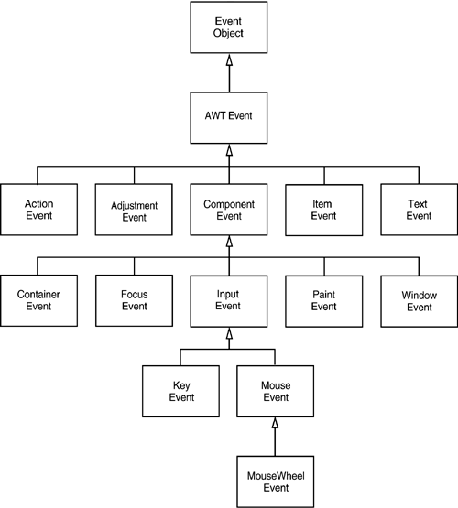
Hierarchy relationship of AWT events
An event is an object of one of the classes in above diagram.

Slide 12
java.util.EventObject class
Superclass of all events.
Constructor
  EventObject(Object source)
Methods
  Object getSource()
  The object on which the Event initially occurred.
  String toString()
  Returns a String representation of this EventObject.
AWTEvent is a superclass of all AWT events that are handled by the delegation event model.
This class and its subclasses supercede the original java.awt.Event class.
int getID() - Returns the event type
java.awt.AWTEvent class

Slide 13
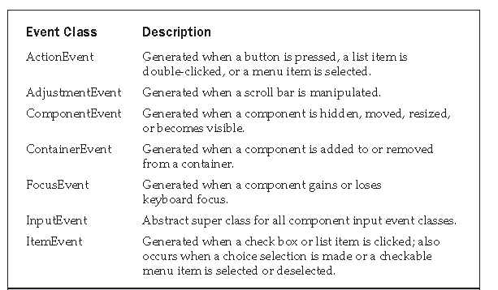
Event classes in java.awt.Event

Slide 14
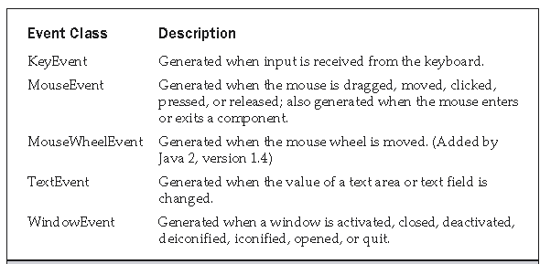
Con’t

Slide 15
java.awt.event.ActionEvent class
Constants
ACTION_FIRST ACTION_LAST ACTION_PERFORMED
ALT_MASK CTRL_MASK META_MASK
SHIFT_MASK
Constructor
ActionEvent(Object src, int type, String cmd)
ActionEvent(Object src, int type, String cmd, int modifiers)
ActionEvent(Object src, int type, String cmd, long when, int modifiers)
Methods
String getActionCommand( )
int getModifiers( )
long getWhen( )

Slide 16
java.awt.event.InputEvent class
Constants(old)
Constants(new)
Methods
boolean isAltDown( )
boolean isAltGraphDown( )
boolean isControlDown( )
boolean isMetaDown( )
int getModifiersEx( )
boolean isShiftDown( )
int getModifiers( )
ALT_MASK BUTTON2_MASK META_MASK
ALT_GRAPH_MASK BUTTON3_MASK SHIFT_MASK
BUTTON1_MASK CTRL_MASK
ALT_DOWN_MASK ALT_GRAPH_DOWN_MASK BUTTON1_DOWN_MASK BUTTON2_DOWN_MASK BUTTON3_DOWN_MASK CTRL_DOWN_MASK
META_DOWN_MASK SHIFT_DOWN_MASK

Slide 17
java.awt.event.KeyEvent class
Three types of key events:
KEY_PRESSED
KEY_RELEASED
KEY_TYPED
VK_0 through VK_9 and VK_A through VK_Z define the ASCII equivalents of the numbers and letters.
  VK_ENTER VK_ESCAPE VK_CANCEL VK_UP
  VK_DOWN VK_LEFT VK_RIGHT VK_PAGE_DOWN
  VK_PAGE_UP VK_SHIFT VK_ALT VK_CONTROL
The VK constants specify virtual key codes and are independent of any modifiers, such as control, shift, or alt.

Slide 18
Con’t
Constructor
KeyEvent(Component src, int type, long when, int modifiers, int code)
KeyEvent(Component src, int type, long when, int modifiers, int code, char ch)
Methods
char getKeyChar( )
int getKeyCode( )

Slide 19
java.awt.event.MouseEvent class
Fields
Constructor
MouseEvent(Component src, int type, long when, int modifiers,int x, int y, int clicks, boolean triggersPopup)
Method
int getX( )
int getY( )
Point getPoint( )
MOUSE_CLICKED The user clicked the mouse.
MOUSE_DRAGGED The user dragged the mouse.
MOUSE_ENTERED The mouse entered a component.
MOUSE_EXITED The mouse exited from a component.
MOUSE_MOVED The mouse moved.
MOUSE_PRESSED The mouse was pressed.
MOUSE_RELEASED The mouse was released.
MOUSE_WHEEL The mouse wheel was moved

Slide 20
Con’t
void translatePoint(int x, int y)
int getClickCount( )
boolean isPopupTrigger( )
int getButton( )

Slide 21
java.awt.event.TextEvent class
Constant
TEXT_VALUE_CHANGED
Constructor
TextEvent(Object src, int type)
Method
String paramString()

Slide 22
java.awt.event.WindowEvent class
Constants
WINDOW_ACTIVATED The window was activated.
WINDOW_CLOSED The window has been closed.
WINDOW_CLOSING The user requested that the window be closed.
WINDOW_DEACTIVATED The window was deactivated.
WINDOW_DEICONIFIED The window was deiconified.
WINDOW_GAINED_FOCUS The window gained input focus.
WINDOW_ICONIFIED The window was iconified.
WINDOW_LOST_FOCUS The window lost input focus.
WINDOW_OPENED The window was opened.
WINDOW_STATE_CHANGED The state of the window changed.

Slide 23
Con’t
Constructors
WindowEvent(Window src, int type)
WindowEvent(Window src, int type, Window other)
WindowEvent(Window src, int type, int fromState, int toState)
WindowEvent(Window src, int type, Window other, int fromState, int toState)
Methods
Window getWindow( )
Window getOppositeWindow()
int getOldState()
int getNewState()

Slide 24
java.awt. event.AdjustmentEvent class
Constants
BLOCK_DECREMENT The user clicked inside the scroll bar to decrease its value.
BLOCK_INCREMENT The user clicked inside the scroll bar to increase its value.
TRACK The slider was dragged.
UNIT_DECREMENT The button at the end of the scroll bar was clicked to decrease its value.
UNIT_INCREMENT The button at the end of the scroll bar was clicked to increase its value.
Constructor
AdjustmentEvent(Adjustable src, int id, int type, int data)
Methods
Adjustable getAdjustable( )
int getAdjustmentType( )
int getValue( )

Slide 25
java.awt.Component class
Constants
COMPONENT_HIDDEN The component was hidden.
COMPONENT_MOVED The component was moved.
COMPONENT_RESIZED The component was resized.
COMPONENT_SHOWN The component became visible.
Constructor
ComponentEvent(Component src, int type)
Method
Component getComponent( )

Slide 26
ContainerEvent class
Container Event is generated when a component is added to or removed from a container.
Constants
COMPONENT_ADDED
COMPONENT_REMOVED
Constructor
ContainerEvent(Component src, int type, Component comp)
Methods
Container getContainer( )
Component getChild( )

Slide 27
MouseWheelEvent Class
It is a subclass of MouseEvent.
Constants
WHEEL_BLOCK_SCROLL A page-up or page-down scroll event occurred.
WHEEL_UNIT_SCROLL A line-up or line-down scroll event occurred.
Constructor
MouseWheelEvent(Component src, int type, long when, int modifiers, int x, int y, int clicks, boolean triggersPopup, int scrollHow, int amount, int count)
Methods
int getWheelRotation( )
int getScrollType( )
int getScrollAmount( )

Slide 28
FocusEvent Class
Constants
FOCUS_GAINED
FOCUS_LOST
Constructor
FocusEvent(Component src, int type)
FocusEvent(Component src, int type, boolean temporaryFlag)
Focus Event(Component src, int type, boolean temporaryFlag, Component other)
Methods
Component getOppositeComponent( )
boolean isTemporary( )

Slide 29
ItemEvent Class
Constants
DESELECTED The user deselected an item.
SELECTED The user selected an item.
Constructor
ItemEvent(ItemSelectable src, int type, Object entry, int state)
Method
Object getItem( )
ItemSelectable getItemSelectable( )
int getStateChange( )

Slide 30
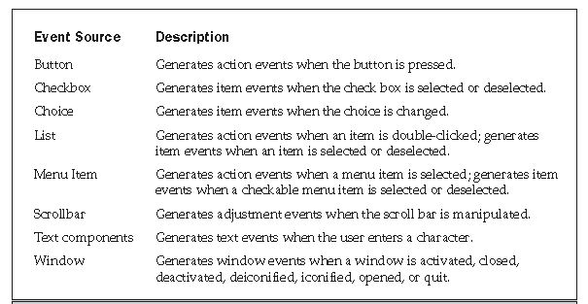
Sources of Events

Slide 31
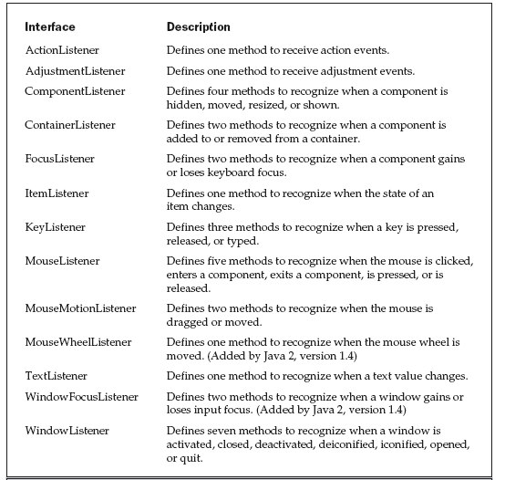
Event Listener Interfaces

Slide 32
The ActionListener Interface
The actionPerformed( ) method that is invoked when an action event occurs.
  void actionPerformed(ActionEvent ae)
The adjustmentValueChanged( ) method that is invoked when an adjustment event occurs.
  void adjustmentValueChanged(AdjustmentEvent ae)
Methods that are invoked when a component is resized, moved, shown, or hidden.
  void componentResized(ComponentEvent ce)
  void componentMoved(ComponentEvent ce)
  void componentShown(ComponentEvent ce)
  void componentHidden(ComponentEvent ce)
The AdjustmentListener Interface
The ComponentListener Interface

Slide 33
The ContainerListener Interface
When a component is added to a container, componentAdded( ) is invoked.
  void componentAdded(ContainerEvent ce)
When a component is removed from a container, componentRemoved( ) is invoked.
  void componentRemoved(ContainerEvent ce)
When a component obtains keyboard focus, focusGained() is invoked.
  void focusGained(FocusEvent fe)
When a component loses keyboard focus, focusLost( ) is called.
  void focusLost(FocusEvent fe)
The FocusListener Interface

Slide 34
The ItemListener Interface
The itemStateChanged( ) method that is invoked when the state of an item changes.
  void itemStateChanged(ItemEvent ie)
The keyPressed() and keyReleased() methods are invoked when a key is pressed and released, respectively.
  void keyPressed(KeyEvent ke)
  void keyReleased(KeyEvent ke)
The keyTyped() method is invoked when a character has been entered.
  void keyTyped(KeyEvent ke)
  E.g. If a user presses and releases the A key, three events are generated in sequence: key pressed, typed, and released.
  If a user presses and releases the HOME key, two key events are generated in sequence: key pressed and released.
The KeyListener Interface

Slide 35
The MouseListener Interface
void mouseClicked(MouseEvent me)
void mouseEntered(MouseEvent me)
void mouseExited(MouseEvent me)
void mousePressed(MouseEvent me)
void mouseReleased(MouseEvent me)
void mouseDragged(MouseEvent me)
void mouseMoved(MouseEvent me)
void mouseWheelMoved(MouseWheelEvent mwe)
The MouseMotionListener Interface
The MouseWheelListener Interface

Slide 36
The TextListener Interface
The textChanged( ) method that is invoked when a change occurs in a text area or text field.
  void textChanged(TextEvent te)
  void windowGainedFocus(WindowEvent we)
  void windowLostFocus(WindowEvent we)
  void windowActivated(WindowEvent we)
  void windowClosed(WindowEvent we)
  void windowClosing(WindowEvent we)
  void windowDeactivated(WindowEvent we)
  void windowDeiconified(WindowEvent we)
  void windowIconified(WindowEvent we)
  void windowOpened(WindowEvent we)
The WindowFocusListener Interface
The WindowListener Interface

Slide 37
Using the Delegation Event Model
Two steps:
Implement the appropriate interface in the listener so that it will receive the type of event desired.
Implement code to register and unregister (if necessary) the listener as a recipient for the event notifications.
A source may generate several types of events.
Each event must be registered separately.
An object may register to receive several types of events, must implement all of the interfaces that are required to receive these events.
SimpleButtonEvent.java
MouseEvents.java
SimpleKey.java
KeyEvents.java

Slide 38
Adapter classes
Adapter class provides an empty implementation of all methods in an event listener interface.
Adapter classes are useful when you want to receive and process only some of the events that are handled by a particular event listener interface.
E.g. MouseMotion Adapter class has two methods, mouseDragged() and mouseMoved().
  The signatures of these empty methods are exactly as defined in the MouseMotionListener interface.
  If you were interested in only mouse drag events, then you could simply extend MouseMotionAdapter and implement mouseDragged( ).
  The empty implementation of mouseMoved( ) would handle the mouse motion events.

Slide 39
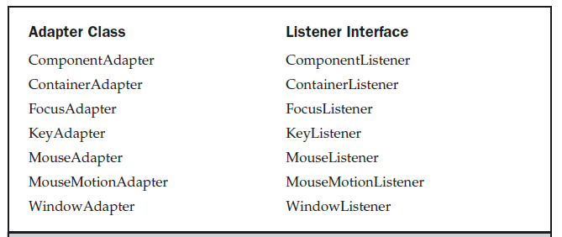
Listener Interfaces implemented by Adapter classes
AdapterDemo.java
MousePressedDemo.java

Slide 40
Inner classes
InnerClassDemo.java
MyMouseAdapter is defined within the scope of InnerClassdemo, it has access to all of the variables and methods within the scope of that class.
Local inner class
Declare an inner class within the body of a method. Such a class is known as a local inner class.
To declare an inner class within the body of a method without naming it.
  These classes are known as anonymous inner classes.

Slide 41
Annonymous classes
An anonymous inner class is one that is not assigned a name.
AnonymousInnerClassDemo.java
new MouseAdapter(){…} – indicates to the compiler that the code between the braces defines an anonymous inner class.
  It is automatically instantiated when this expression is executed.
Anonymous inner class is defined within the scope of AnonymousInnerClassDemo, it has access to all of the variables and methods within the scope of that class.

Slide 42
Semantic and Low-Level Events in the AWT
Low level events are those produced by the keyboard, mouse and those related to windows and are common to all the components: KeyEvent, FocusEvent, MouseEvent, WindowEvent, ComponentEvent and ContainerEvent.
  Keyboard and mouse are regarded as low level input.
A semantic event is one that is specific to one particular component. E.g. "clicking a button"; hence, an ActionEvent is a semantic event.
Low-level events are those events that make this possible. In the case of a button click, a mouse down is low-level event.
Adjusting a scrollbar is a semantic event, but dragging the mouse is a low-level event.

